Slide 1
DAY 13 PPT
PTHREADS

Slide 2
pthread
Pthreads, or POSIX Threads, are a standard API (Application Programming Interface) for creating and manipulating threads in Unix-like operating systems, including Linux, macOS, and various flavors of Unix. Pthreads provide a portable and standardized interface for multi-threaded programming.
Here are some key aspects of pthreads and their functions:
Thread Creation: The pthread_create function is used to create a new thread. It takes several parameters, including a pointer to a pthread_t variable that will hold the identifier of the newly created thread, thread attributes, a function pointer to the function that the thread will execute, and any arguments that need to be passed to that function.
Thread Termination: Threads can terminate in several ways. They can return from the start routine specified in pthread_create, or they can be canceled by another thread using pthread_cancel. The pthread_join function is used by a thread to wait for the termination of another thread. This function blocks the calling thread until the specified thread terminates.
Thread Synchronization: Pthreads provide several synchronization mechanisms, including mutexes (pthread_mutex_t), condition variables (pthread_cond_t), and barriers (pthread_barrier_t). Mutexes are used to protect shared resources from simultaneous access by multiple threads. Condition variables are used to block and unblock threads based on some condition. Barriers are used to synchronize multiple threads at a specific point in their execution.
Thread Attributes: The pthread_attr_t type is used to specify attributes for newly created threads. Attributes include stack size, scheduling policy, and priority.
Thread-Specific Data: Pthreads provide functions for managing thread-specific data using pthread_key_create, pthread_setspecific, and pthread_getspecific.

Slide 3
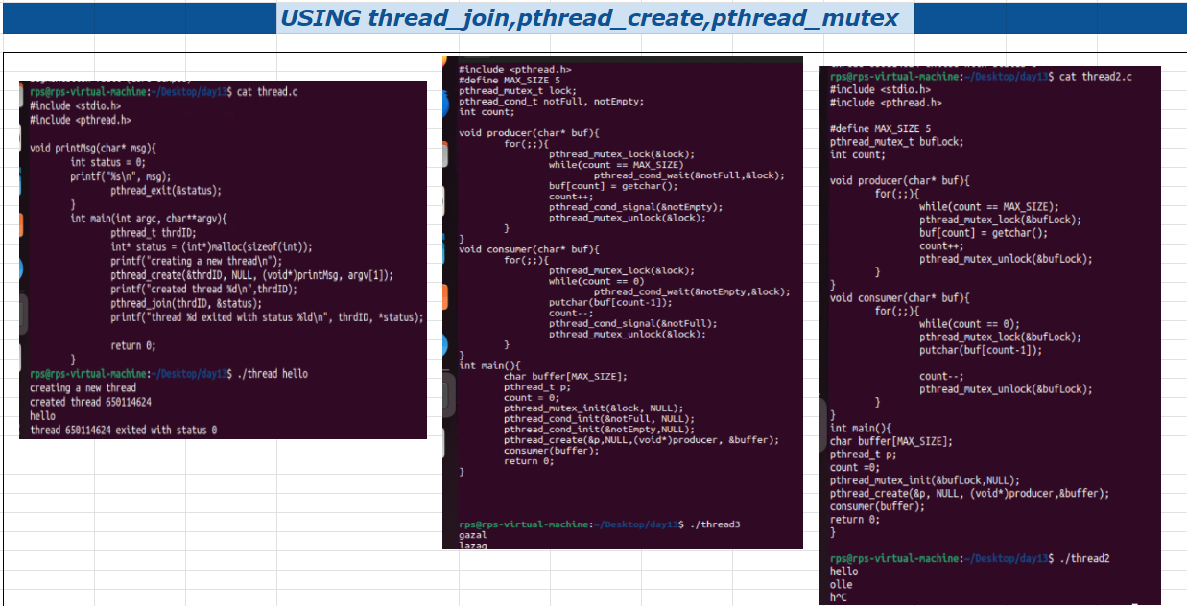
Program with pthread

Slide 4
PTHREAD_MUTEX_LOCK
pthread_mutex_lock is a function in the POSIX threads (pthread) library used for synchronizing access to shared resources in multithreaded programs. When multiple threads need access to shared data, it's crucial to ensure that only one thread accesses the data at a time to prevent race conditions and maintain data consistency.
Here's a brief overview of how pthread_mutex_lock works:
Mutex Initialization: Before using a mutex, you need to initialize it using pthread_mutex_init.
Locking: When a thread wants to access the shared resource, it calls pthread_mutex_lock on the mutex associated with that resource. If the mutex is currently unlocked, the calling thread successfully locks it and proceeds. If the mutex is already locked by another thread, the calling thread blocks until the mutex becomes available.
Unlocking: After the thread finishes using the shared resource, it unlocks the mutex by calling pthread_mutex_unlock. This allows other threads waiting on the mutex to acquire it and access the shared resource.

Slide 5
PTHREAD_JOIN
pthread_join is another function in the POSIX threads (pthread) library. It's used for waiting for a thread to terminate and obtain its exit status. When a thread is created using pthread_create, it runs asynchronously with the calling thread. If the calling thread needs to wait for the created thread to finish its execution before proceeding further, pthread_join is used.
Here's a brief overview of how pthread_join works:
Waiting for Thread Termination: The calling thread blocks until the specified thread terminates. If the thread has already terminated by the time pthread_join is called, pthread_join returns immediately.
Obtaining Thread's Exit Status: pthread_join optionally stores the exit status of the terminated thread. The exit status is a pointer to the location where the exit status will be stored. If the exit status is not required, NULL can be passed instead.
Cleaning up Resources: Once pthread_join returns, the resources associated with the terminated thread (such as its stack) can be safely released by the system.

